Slide 1
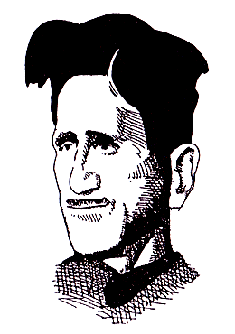
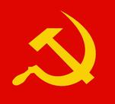
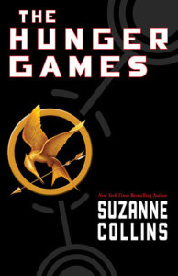
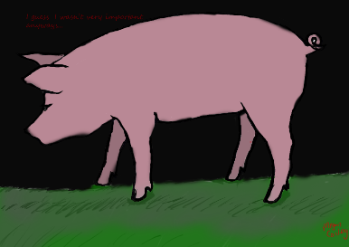
Animal Farm
Author: George Orwell
Context: Communism and Capitalism
Genre: Dystopian fiction, allegorical fiction

Slide 2
About the author… George Orwell
Real name: Eric Blair (1903-1950)
Chose his pen name because of his love of England
George = Patron Saint of England
Orwell = The river Orwell was his favorite location
Family had social status, but they weren’t rich
Orwell purposefully lived in poverty for some time, because he wanted to know what it felt like to have so little
Viewed himself as a voice for the “downtrodden”

Slide 3
More on Orwell
Worked as a journalist
Outspoken critic of Communism and Russian dictator Joseph Stalin, as in his famous novels Animal Farm and 1984
Died young (age 46) of tuberculosis
Orwell was a Socialist, which is not the same as Communist

Slide 4
INTERMISSION
Talk with your peers about Communism and Capitalism
Jot down on one side of a sheet of paper what you know about Communism and Capitalism
Jot down on the other side what you are not sure about when it comes to Communism and Capitalism

Slide 5
Communism, Capitalism, Socialism, oh my!
Who has the power:
Democracy: Ruled by majority (demos = the people)
Republic: Less about majority rule and more about checks and balances
Communism: Ruled by single political party at start, then everyone equally
Types of economy:
Capitalism: Individuals have more economic power, free market
Socialism: Distribution of wealth, higher taxes for more services
Political ideology:
Left-wing/progressive: Wants to change the system
Right-wing/conservative: Wants to preserve the system

Slide 6
Genre: Dystopian
Utopia = a perfect society
Dys = Not (think “dysfunctional”)
Dystopia = an imperfect society
Dystopian fiction represents a society that might appear at first to be much better than our own, but the society is majorly flawed and often in some way dangerous to human freedom.
Examples:
The Hunger Games
The Giver
Fahrenheit 451
Animal Farm and 1984
Brave New World
A Clockwork Orange

Slide 7
Genre: Allegorical
Allegory = A long work where nearly everything in the work represents something else… Think of an extended metaphor
There will be at least two meanings: one of the surface and one under the surface
Real people, real ideas, and real events are represented by fictional symbols
Examples:
The Chronicles of Narnia
Animal Farm
Lord of the Flies
The Wonderful Wizard of Oz (arguably!)

