Slide 1
Archetypes
The recurring ideas in storytelling

Slide 2
Archetypes Notes #1
CHARACTER ARCHETYPES

Slide 3
What is an Archetype?
Artchetypes are types of ideas that can be found in many stories throughout history.
They exist throughout many different cultures, throughout many different time periods– from ancient Greece to modern day.
Archetypes can be recurring:
Characters (the hero, the villain, the mentor, the damsel in distress)
Images and symbols (light vs. dark, the underworld)
Reading ancient stories, such as The Odyssey, can help us understand our own modern stories better and help us see that most stories have a lot in common with each other

Slide 4
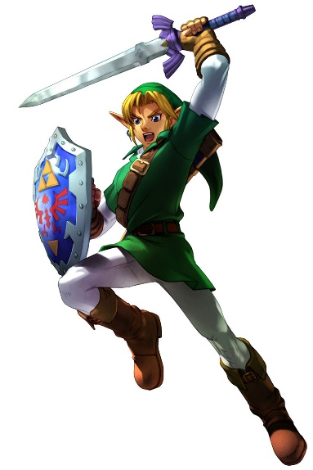
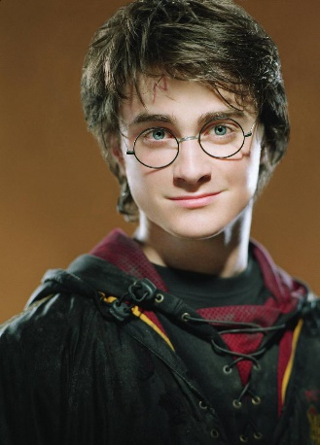
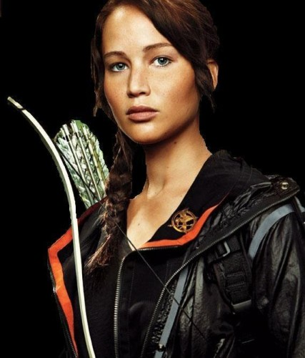
the hero
“The Hero” is the most common type of protagonist, the “good guy”
A born leader (he may be “the chosen one”) willing to go on a journey to fight evil
An “epic hero,” like Odysseus in The Odyssey, has these characteristics:
Superhuman qualities
Suffers trials to achieve a goal
On a quest of some great value
Has a tragic flaw
Unusual/prestigious origin

Slide 5
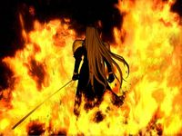
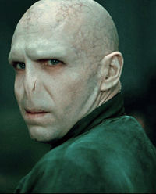
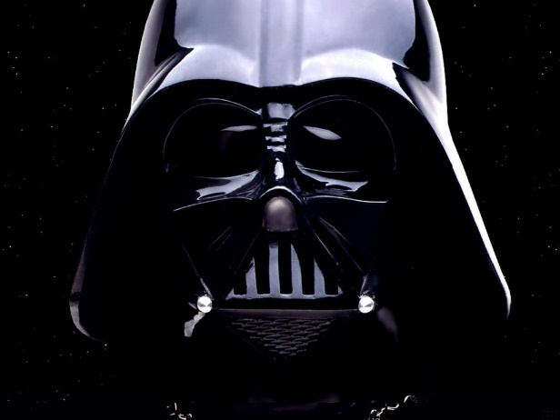
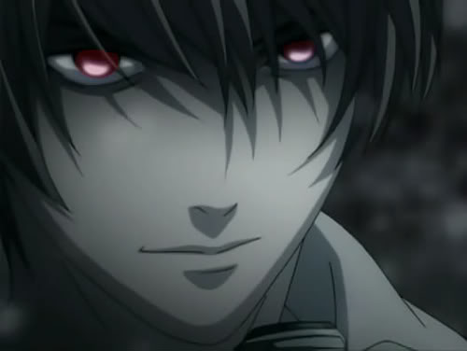
the villain
If we have a “hero,” you can expect that we’ll have a “Villain.”
The “villain” is a character who is guilty or capable of evil.
This character represents problems that humans want to eliminate.
The hero must defeat the villain, who breaks the laws of man and nature.
Poseidon is the antagonist in The Odyssey, but there’s no real villain.
The Trojans, the Lotus Eaters, and Circe are also villain-like.

Slide 6
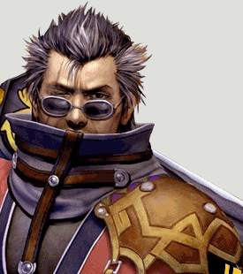
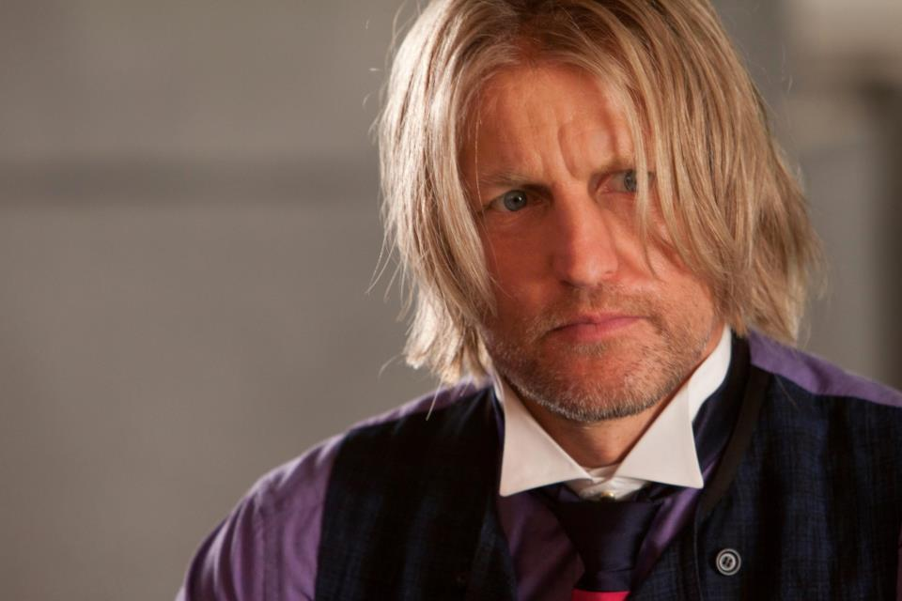
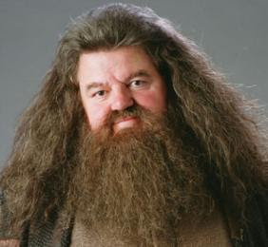
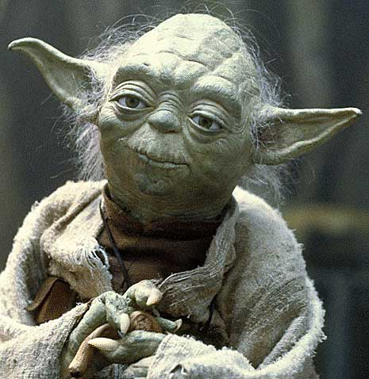
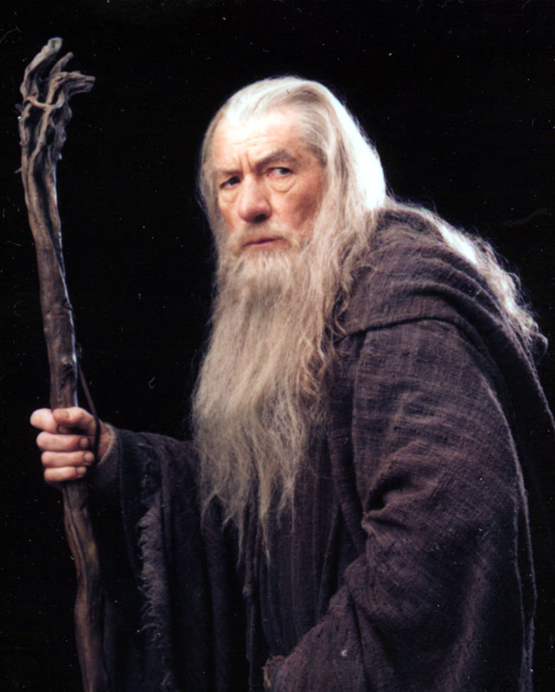
The mentor
“The mentor” aids or trains the hero.
This character is usually wise and old, but not all the time!
This character represents wisdom, experience, and goodness.
In The Odyssey, the goddess Athena acts as Odysseus’s mentor

Slide 7
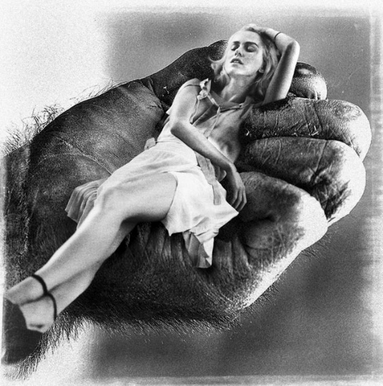
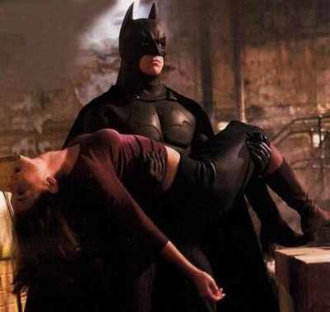
The damsel in distress
The “damsel in distress” is in danger and needs saving from the hero.
This usually a young woman, especially a love interest.
The “damsel in distress” is often innocent and defenseless against evil.
In The Odyssey, Penelope acts as a damsel in distress. However, she is clever and not totally defenseless.

