Slide 1
early British literature
King James bible to Chaucer

Slide 2
What is British literature?
Literature made in Britain. Whew, that was tough. See ya later!
Okay. More specifically: Literature from the United Kingdom
England
Scotland
Wales
And, depending on how you view things, Irish literature as well.
1st “quarter”: KJV Bible, Beowulf, Canterbury Tales
British Literature is commonly taught as a 12th grade course in high school, following an American literature course in 11th grade… But if we’re all Americans, why would we have a whole year on British literature?

Slide 3
Periods of British literature
450-1200 | Anglo-Saxon Old English | Beowulf
1200-1500 | Medieval Period Middle English | Geoffrey Chaucer
1500-1558 | Tudor Period Humanist Era | Thomas More John Skelton
1558-1603 | Elizabethan Period Renaissance Era | Edmund Spencer William Shakespeare
1603-1625 | Jacobean Period Metaphysical poets | John Donne George Herbert
1625-1649 | Caroline Period | John Milton
1649-1660 | Commonwealth Baroque | Andrew Marvell Thomas Hobbes
1660-1700 | The Restoration | John Dryden

Slide 4
Periods of British literature
1700-1800 | The Enlightenment Age of Reason Neoclassical Period | Alexander Pope Jonathan Swift Samuel Johnson
1785-1830 | Romanticism | William Wordsworth S.T. Coleridge Jane Austen Bronte sisters
1830-1901 | Victorian Period | Charles Dickens George Eliot Robert Browning Alfred Lord Tennyson
1901-1960 | Modernism | H.G. Wells James Joyce T.S. Eliot George Orwell
1960- present | Postmodernism | Ted Hughes John Fowles

Slide 5
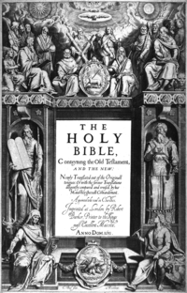
Importance of the bible
We’re starting our survey of British Literature with the Bible, not to teach you religion but to look at the Bible as literature
The Catholic Church (which was the church at the time) stood strong after the fall of Rome in the 5th century… And for the next 1000 years+, the Catholic Church would be one of, if not the most influential power structures in all of Europe, including Britain
The Bible, as interpreted and taught by Catholic priests, influenced public laws and personal morality and gave people a purpose and understanding of the world before modern science
The vast majority of people would have believed the Bible to be 100% true, the Word of God, so understanding a basic idea of the Bible will help us understand the mindset of the authors and audiences of the texts we’ll be reading throughout the year
Futhermore, many of the texts we read this year are going to reference the Bible, so knowing a bit more about it will help us notice and appreciate the allusions
We’re going to read the King James Version because it was the major translation of the Bible from the 1600s until about the 1900s and gets us used to reading early modern English for when it comes time to read Shakespeare’s Hamlet later this semester

Slide 6
Anglo-Saxon / old English lit
This refers to the earliest period of English literature, when the language was still just starting and sounded almost nothing like it does now – We’re talking like 1,000 years ago
Very few writings from this period survived, largely because there wasn’t a lot of text written in Old English that were being well-preserved other than the Scandinavian epic Beowulf
Most fictional stories from this time, like Beowulf, take the form of legends or tales of war and are written in poetic form
When we read Beowulf, notice how the early Viking-esque culture is starting to mix with early Christianity

Slide 7
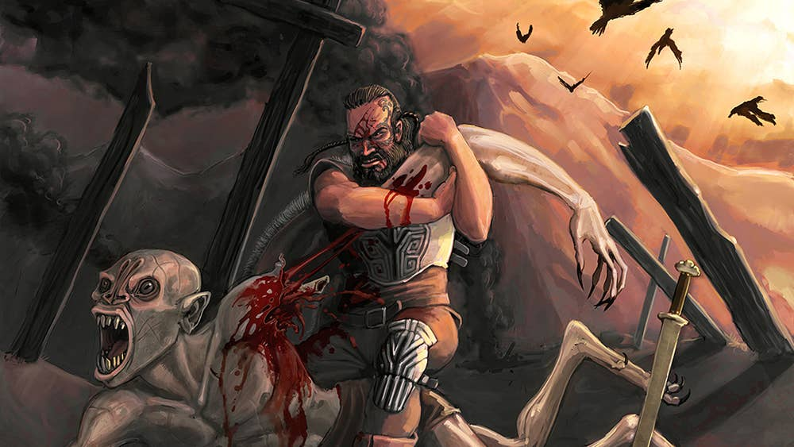
Anglo-Saxon / old English lit
Hwæt. We Gardena in geardagum,
þeodcyninga, þrym gefrunon,
hu ða æþelingas ellen fremedon.
Oft Scyld Scefing sceaþena þreatum,
monegum mægþum, meodosetla ofteah,
egsode eorlas. Syððan ærest wearð
feasceaft funden, he þæs frofre gebad,
weox under wolcnum, weorðmyndum þah,
oðþæt him æghwylc þara ymbsittendra
ofer hronrade hyran scolde,
gomban gyldan. þæt wæs god cyning.

Slide 8
Medieval period / middle English
Old English transitioned to Middle English around the year 1200
The period we refer to as the “Middle Ages” (aka Medieval Era) spans from about 1200 to the 1500s
During this time, writings were often very religious in nature, partially because that’s what people believed and also partially because the Church was the center of learning… The monks were the ones recording and preserving literature, and heresy was a crime punishable by death in many, many cases.
This was also the time of courtly love and chivalry, and we also saw translations of the Bible into English, along with the resurgence of Greek and Latin as a language of learning, thus spilling Latin and Greek words into the developing English language
Our third reading of this “quarter,” after the KJV Bible excerpts and abridged reading of Beowulf, will be a two of the stories from Chaucer’s Canterbury Tales, which was hugely influential in popularizing English as a language for literature

Slide 9
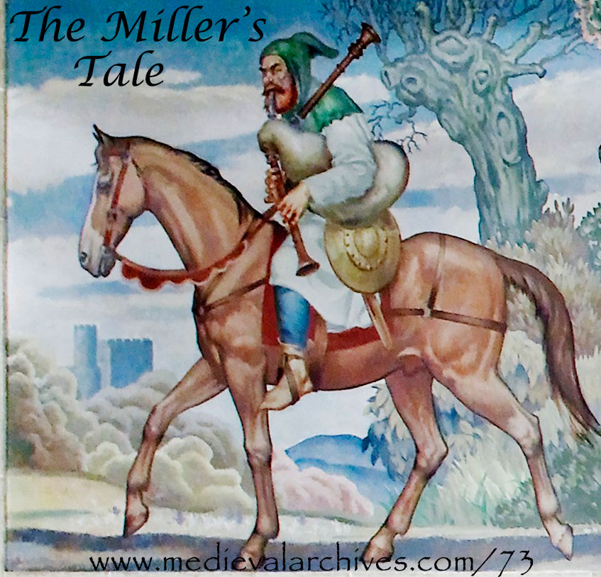
Medieval period / middle English
Whilom ther was dwellynge at Oxenford
A riche gnof, that gestes heeld to bord,
And of his craft he was a carpenter.
With hym ther was dwellynge a poure scoler,
Hadde lerned art, but al his fantasye
Was turned for to lerne astrologye,
And koude a certeyn of conclusiouns,
To demen by interrogaciouns,
If that men asked hym in certain houres
Whan that men sholde have droghte or elles shoures,
Or if men asked hym what sholde bifalle
Of every thyng; I may nat rekene hem alle.

