Slide 1
A brief history of American literature
I mean, it has to be brief. Ain’t nobody have enough time to talk about two hundred or so years of stuff like this.

Slide 2
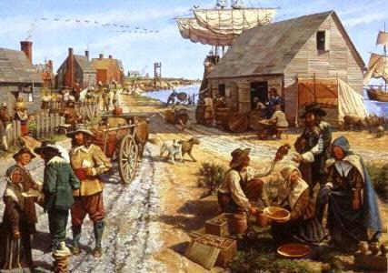
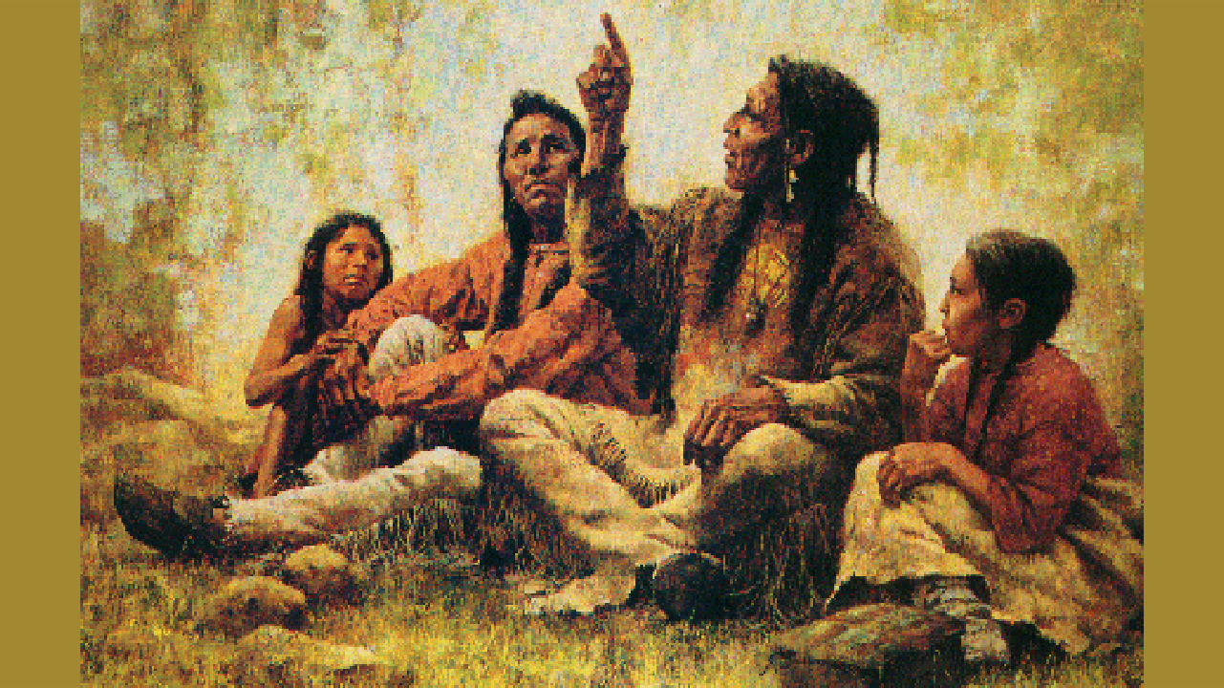
When does American literature begin?
American literature has two start points… depending on how you’re looking at it.
Start point #1: When European (especially British) colonies began to settle in North America.
Start point #2: American literature began a long, long time ago, with the native tribes already living on the continent.

Slide 3
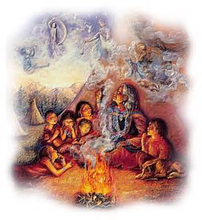
Native american storytelling
More than 500 different tribal languages were spoken in North America before the first Europeans arrived. None had been in writing.
American tribes orally passed on myths, legends, tales, and lyrics
Many different cultures populated the continent, and the stories reflected a wide variety of religious and political identitites
Native American stories revere nature (alive and full of spiritual forces).

Slide 4
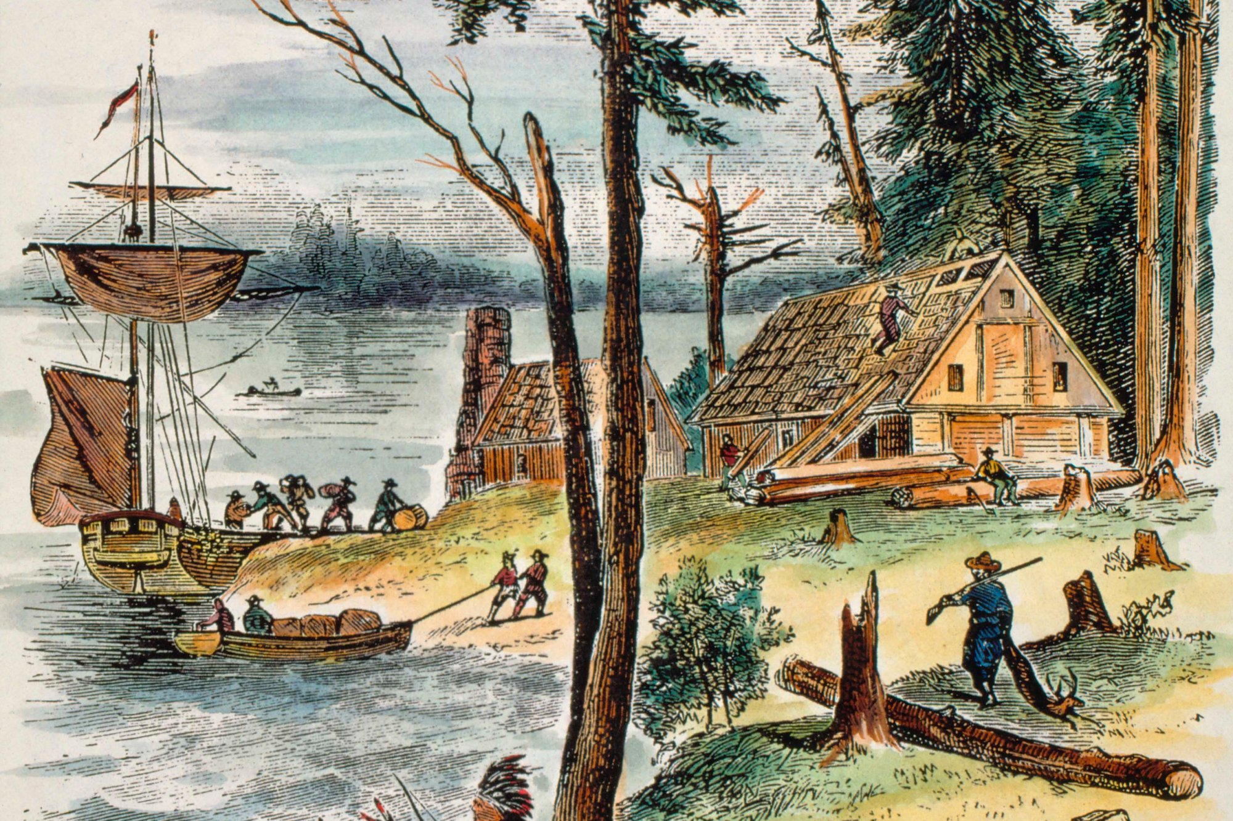
The 17th century
In the 17th century, European pirates and adventurers began to explore North America, in search of prosperity and more freedom.
Early colonial literature was comprised of diaries, letters, travel journals, and ship logs. These artifacts give us a vivid picture of what life was like then.
One of the groups coming to North America were the Puritans, who fled religious persecution in England.

Slide 5
The Puritans defined good writing as writing that made people aware of the importance of worshipping God and the spiritual dangers facing the world.
Some Puritan literature is very complex and philosophical, and some are homely journals.
Puritans believed that earthly success was a sign that God had saved the individual, so as Puritan roots began to grow deeper in North America, the foundation for a capitalist nation was also being sown into the land.
For Puritans, there was no separation between secular and religious life: everything is a symbol that points to something either coming from God or from the Devil.

Slide 6
When the United States won independence from England, there was no such thing as “American literature.”
By many accounts, it was not until the 1800s that a clear American identity was forming. American literature began to be recognized by scholars as being worthwhile to European counterparts.
We are going to focus on three major movements in literature this quarter:
Romanticism, Realism, and Naturalism.

Slide 7
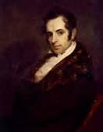
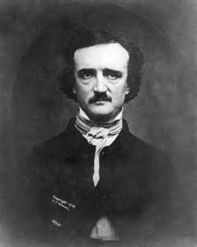
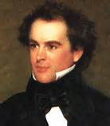
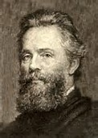
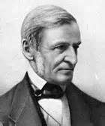
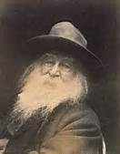
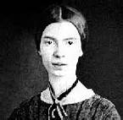
Movement 1: Romanticism
Washington Irving
Edgar Allen Poe
Nathaniel Hawthorne
Herman Melville
Emphasis on imagination and emotion
Praised the individual/common man
The supernatural, not love stories
Transcendentalism: branch of Romanticism that emphasized the spirit and nature as symbolic of God
Emerson… Whitman…. Dickinson

Slide 8
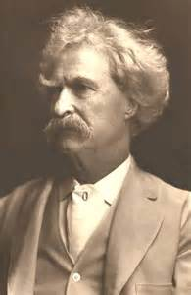
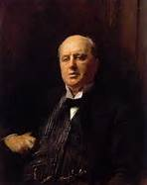
Movement 2: realism
Mark Twain
Henry James
Started after the Civil War and increased emphasis on industrialization
Many people were becoming frustrated and disillusioned with the American dream
Realism was a reaction against Romanticism: Realist literature was interested in everyday realities of life
Life = brutal and hard

Slide 9
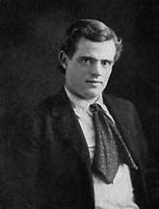
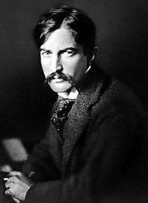
Movement 3: naturalism
Jack London
Stephen Crane
During the last decade of the 1800s
Writing about subjects from lower ranks of societies: Poverty, misery
Victims of society and nature
The individual human is not the force of good portrayed in Romantic writing
Humans = beasts who act on impulse

Slide 10
REVIEW: history of american literature
“American literature” has two starting points, depending on how you look at it:
Starting point 1:
Starting point 2:
During the 17th century, fleeing from persecution, this religious group came to America…
The Puritans believed that there was a direct connection between salvation and having…
Three major literary movements during the 1800s:
Movement 1: (nature as supernatural, common man is best thing since sliced bread)
Movement 2: (nature as brutal and hard, life is frustrating due to the Civil War and industrialization)
Movement 3: (nature as miserable, people are being broken down and are beast-like)

