Slide 1
Interstellar and the “Human Condition”
By: Tara Binstock

Slide 2
Introduction
Interstellar is a 2014 science fiction movie directed by Christopher Nolan.
Information…
I agree with Interstellar, it gives a positive view on human life.
A.I is a 2001 science fiction movie directed by Steven Spielberg.
Information…
I agree with A.I., it gives an accurate view on human life.

Slide 3
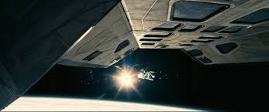
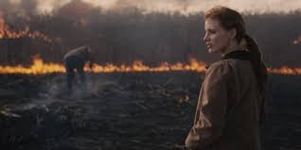
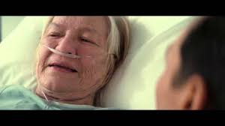
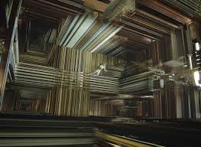
Overview

Slide 4
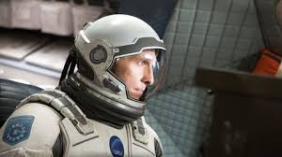
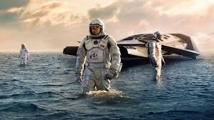
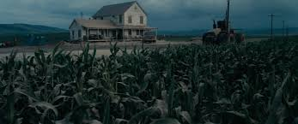
Overview: 1/2
It is set in the future.
The world is facing a big dust storm.
There are a bunch of farmers.
All they plant is corn
The weather/ dust is having an affect on everyone.
Hard to breathe, you have to wipe off things, wear mask and eye protection.
Cooper, the father, he really cares about his daughter and son.
Murph is the daughter and Tom is the son.

Slide 5
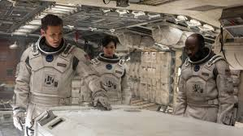
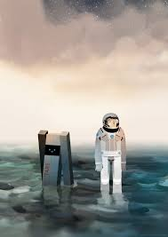
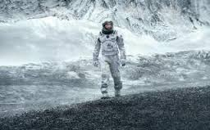
Overview: 2/2
Professor Brand is working on trying to get the world to survive on a different planet in space.
He wants to transport the humans into a wormhole.
Also, he is seeing if you can plant corn out in space.
His daughter Brand, has a Plan B.
Professor wants to stick with Plan A.
Professor Brand, has to find someone to go out in space and he asked Cooper.
He was a former NASA pilot.
Cooper also has a team of researchers.
The team is asked to go across space.
Many things happen on the way.

Slide 6
View on Human life

Slide 7
View on human life 1/1
Love
Chemicals
So much meaning, but does it mean that much.
Selfish
Mann
Hurting people
Knowing the truth
Selflessness
Cooper
Choices

Slide 8
Comparing Interstellar to A.I.

Slide 9
Comparing 1/1
Interstellar
A.I.
Love
humans make it mean so much but does it actually?
Machines~ Humans/ helps
Blue Fairy
Mother back
dark or good
Machines~ future

Slide 10
Own Thoughts

Slide 11
Own thoughts
Interstellar~ love
A.I.~ jealousy

Slide 12
Works Cited
Christopher, Nolan. Interstellar. Paramount Pictures., 2014.
Spielberg, Steven. A.I.. Warner Bros., 2001.

