Slide 1
It and the Human Condition

Slide 2
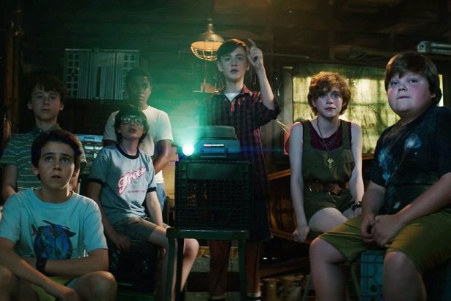
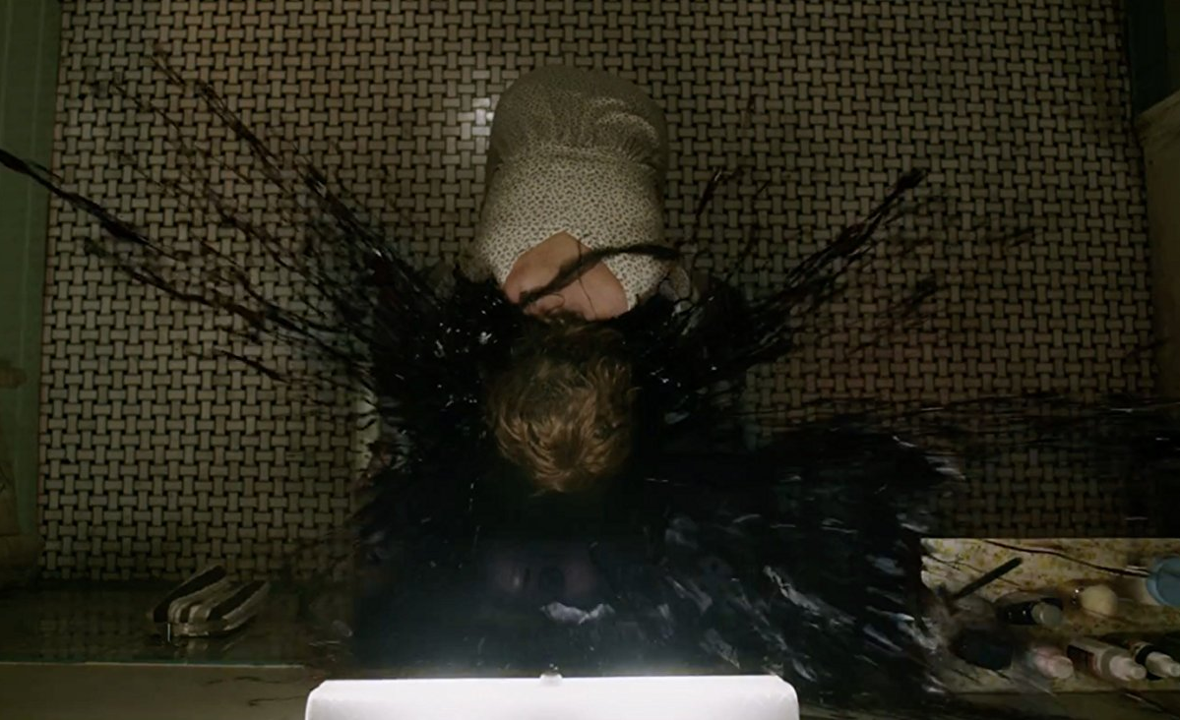
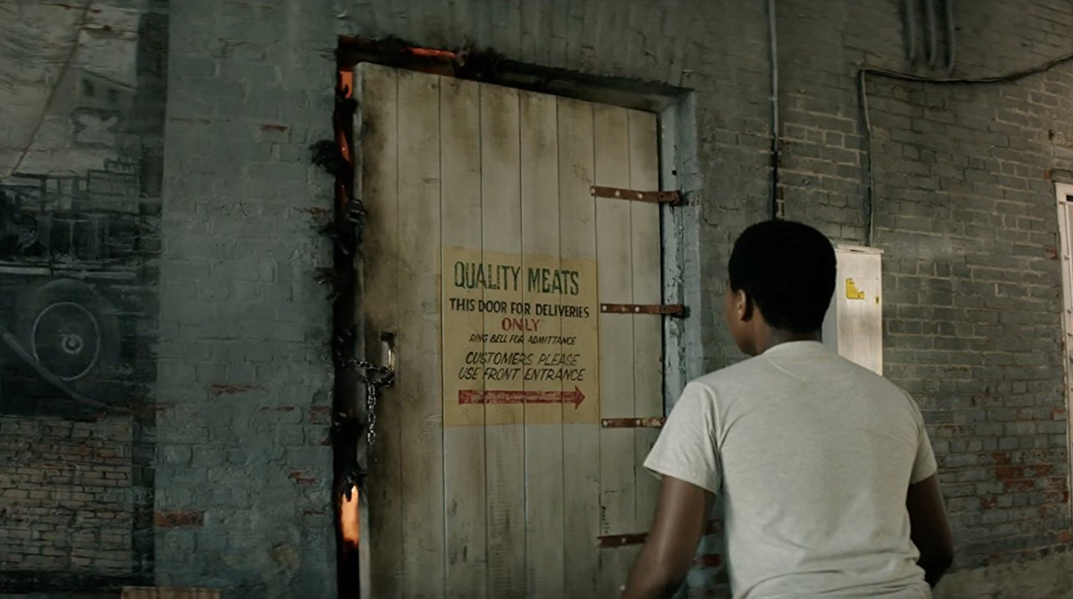
Overview (1/2)
Set in October 1988 in Derry, Maine
Georgie and IT
Ben, Stan, Eddie, Richie and Bill band together
Believes Georgie is still alive – search in the Barrens
Mike and Bev join the group
Each has seen IT in their own way
Headless boys, fountains of blood, the rotting man (leper),
the flute lady, Mike’s parents, and Georgie’s ghost
IT reappears every 27 years
Each confrontation, he isolates and terrifies them

Slide 3
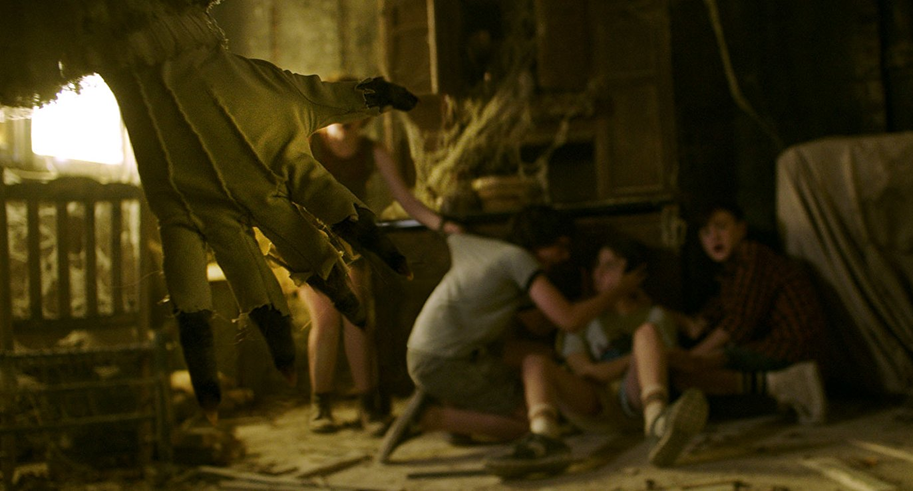
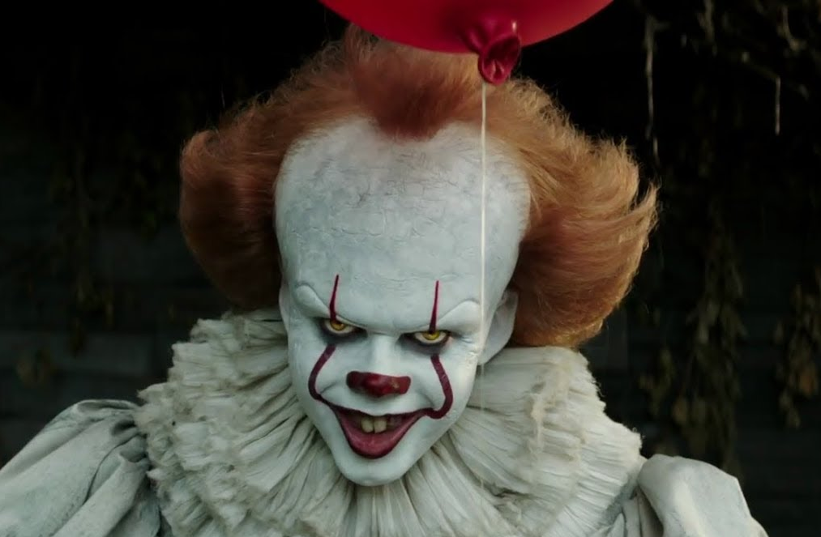
Overview (2/2)
Group splits after first confrontation with IT
Abandoned house, broken arm, impaled
Beverly confronts father, gets kidnapped
Group joins together to rescue her
The group goes into sewers through well
Pennywise holds Bill hostage
Will spare children if they let him keep Bill
Kids refuse, overcome their fears, defeat IT, the
beast retreats, and the kids make their promise

Slide 4
What It says about human life
Traumatic experiences = repression
IT uses repressed fears to attack and weaken children
Fear dominates our behaviors on simple and extreme levels
Simple – Avoiding the house on Neibolt street
Extreme – Causes Eddie to have asthma attacks
Fear lies at the root of most of our problems
Conquering our fear = incredible strength and power

Slide 5
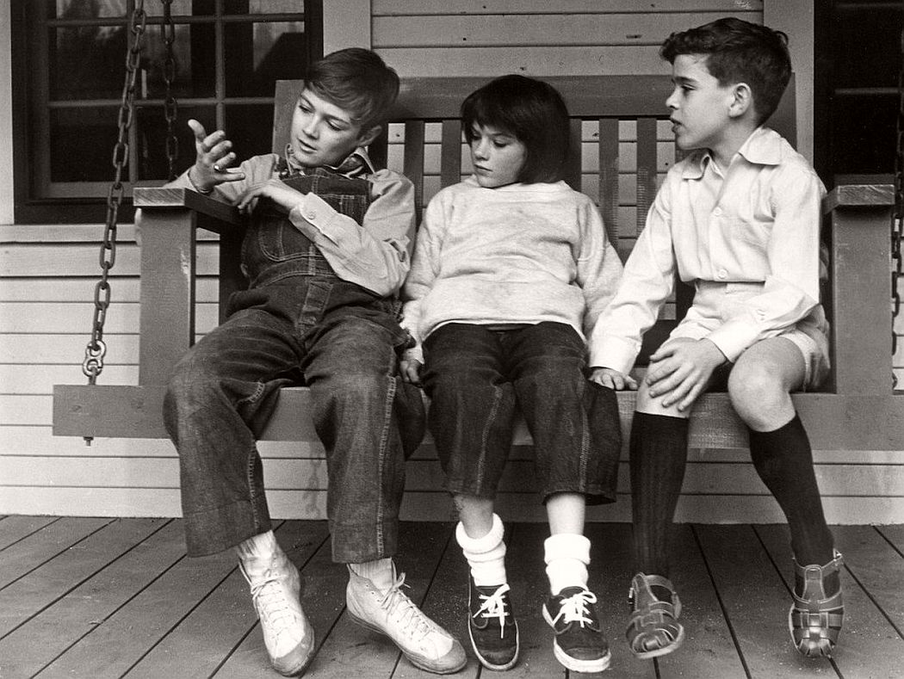
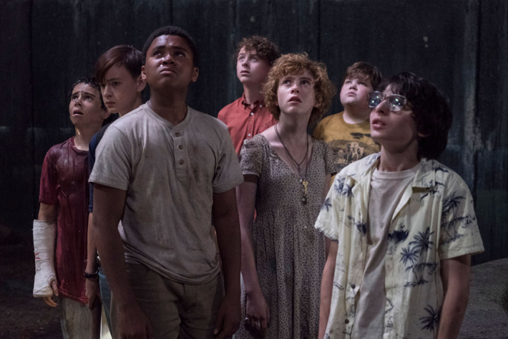
Comparing It to To Kill A Mockingbird
Groups of children (related and friends) come
together to overcome a fear
Fear controls their lives throughout the story
Both groups overcome their fear of the monster
It = overcome and conquer the beast
Kids win, get Bev back, and get over their repressed fears
TKAM = overcome and see everything from the Boo’s perspective
After being saved, Scout and Jem overcome their fear and
grow to like Boo

Slide 6
It, Sigmund Freud, and the aspect of fear (1/2)
Our behaviors and actions when in a state of fear are caused by our Id
Repression is an unconscious mechanism
Employed by the ego as a form of protection against threatening/disturbing thoughts
Causes us to forget traumatic things in our lives
Mike and his parents, Eddie and the rotting man (leper), etc.
Physical symptoms caused by repressed trauma
Eddie’s asthma

Slide 7
It, Jacques Lacan, and the aspect of fear (2/2)
Fear of the Real
The Real = something that cannot be expressed in words
Experiences in the children’s lives force them to create a phobic object to fill the void
Bev’s abuse, Eddie’s mother, Mike’s parents, etc. = Pennywise
There’s a need to express this fear of the Real, but can be difficult because of how indescribable the Real is
Pennywise is a physical object symbolic of the Real that can reflect the unconscious fear the children can’t put into words.

Slide 8
My thoughts
I agree with how It portrays fear
Fear is rooted in every aspect of our life
Control it or it will control you
Fear is an emotion that must be expressed
Expressing these emotions can be healthy

Slide 9
Works Cited
Muschietti, Andy, director. It. Warner Bros., 2017.
Lee, Harper. To Kill A Mockingbird. Hachette, 1960. 1982.
McLeod, S. A. “Sigmund Freud.” Simply Psychology. N.p., n.d., www.simplypsychology.org/Sig60mund- Freud.html. Accessed 2 May 2018.

