Slide 1
Allegories
Imagine an iceberg…
how it looks one way at the top
and so much greater beneath the surface.

Slide 2
Metaphors, fables, and parables
Metaphor: When you say something is something else, when it’s not literally
“Life is a highway”
The cake metaphor from Touching Spirit Bear
Fable: A short story, typically with animals as characters, conveying a moral
Parable: A simple story used to illustrate a moral/spiritual lesson (esp. the Bible)
Metaphors and parables are closely related to allegory, and in many cases they mean the same thing.

Slide 3
Allegory
Allegory: A story, poem, or picture that can be interpreted to reveal a hidden meaning, typically a moral or political one
In other words, an allegory is something that appears to be one thing on the surface (or literally) but also clearly represents something political/religious/moral underneath the surface

Slide 4
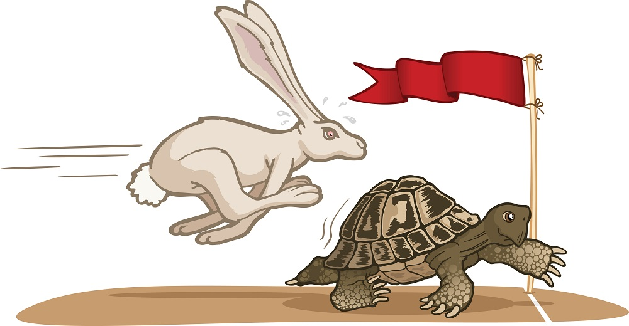
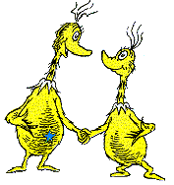
Examples: Aesop’s Fables and Dr. Seuss
Aesop’s Fables
Tortoise and the Hare
The Ant and the Grasshopper (aka Bug’s Life)
Dr. Seuss
The Sneetches
Yertle the Turtle

Slide 5
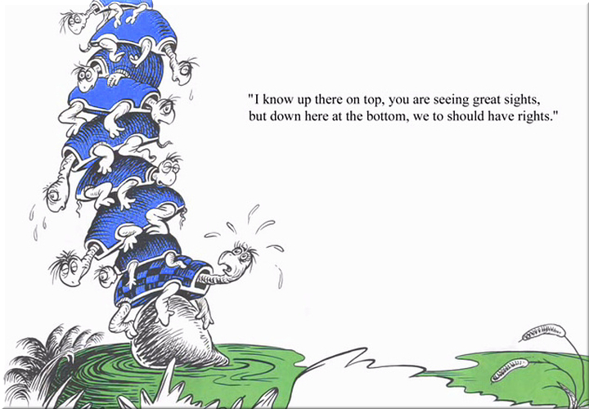

Slide 6
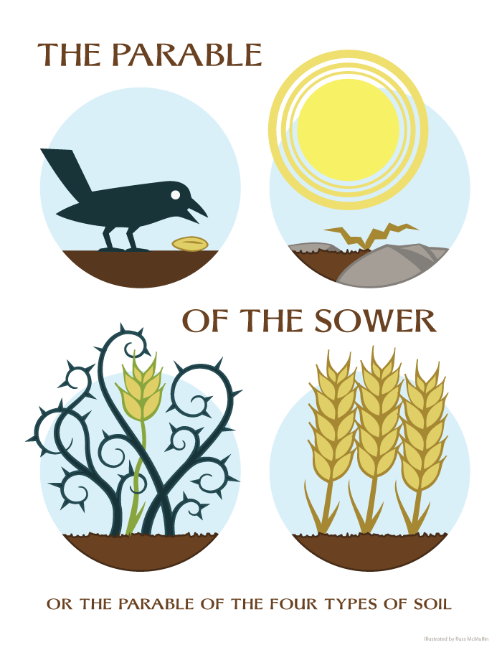
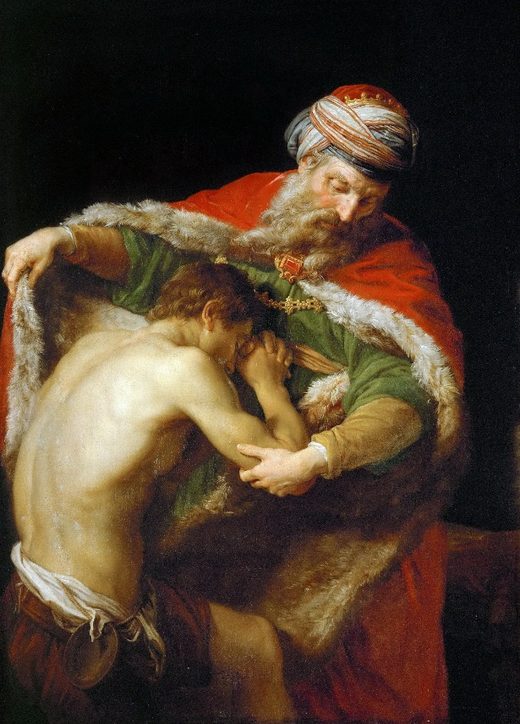
Examples: Parables in the New Testament
Parable of the Sower
Good Samaritan
Wise and Foolish Builder
Prodigal Son

Slide 7
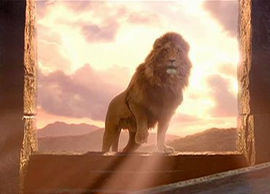
Examples: The Chronicles of Narnia
The Chronicles of Narnia is a giant allegory for Christianity
The Lion, the Witch, and the Wardrobe (2nd book) describes Aslan’s death and resurrection
The Last Battle (6th and last book) explains how Aslan returns and takes his believers to a kingdom in the afterlife

Slide 8
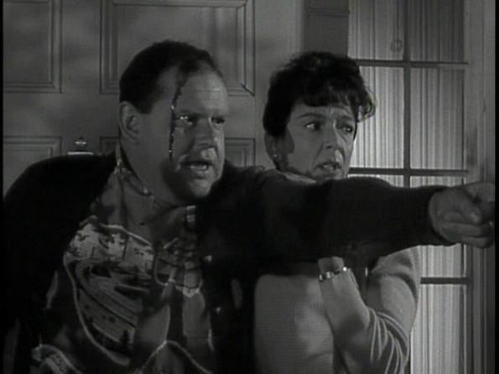
“The Monsters are Due on Maple Street”
Soon we’ll be watching “The Monsters are Due on Maple Street”
This is an episode of the 1960s television program The Twilight Zone
This episode was written during the Cold War, when everyone was afraid their neighbors are Communists
On the surface, this episode is talking about paranoia over alien invaders, but under the surface, it’s a safe way for the show to criticize American paranoia without getting into trouble…

Slide 9
Quick recap!
What is an allegory?
What is an example of allegory that we talked about– and what makes it an allegory?
Can you think of any other examples of allegory that we haven’t talked about yet?

