Slide 1
Reading Signposts

Slide 2
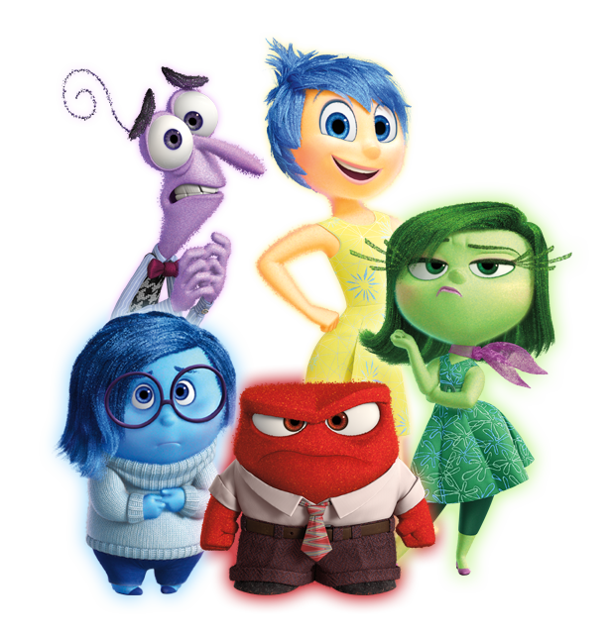
Review…
What is theme?
What is mood?
What is tone?
What does the plot pyramid look like?
What purposes do author’s write for?

Slide 3
What are reading signposts?
“Clues” within a story that help you get more out of what you’re reading.
Authors don’t always put them in on purpose, and they’re called by different names, but they’re EVERYWHERE – and not just in books! What other types of stories are there?
Signposts help you:
Draw inferences about the conflict and plot
Identify and trace a theme of the story
Pick up on foreshadowing for what will happen later
Notice the small details that give meaning to the story

Slide 4
1. Contrasts and Contradictions
What is it: Something unexpected happens
What does it do: Reveals character/plot/conflict, foreshadows
“Giveaway” signs:
Someone acts “out of character”
Someone acts totally unlike a “normal” person
One character is acting differently from the others

Slide 5
2. AHA Moment
What is it: Someone suddenly realizes something important
What does it do: Reveals theme, could resolve conflict
“Giveaway” signs:
Someone literally says “Aha!”
The character/narrator says “I suddenly realized”
“Then it hit me”
“I finally figured it out”

Slide 6
3. Words of the wiser
What is it: Wise character gives important advice to the protagonist
What does it do: Reveals theme, character development
“Giveaway” signs:
Older character is a sage/wizard/parent-figure
Younger protagonist needs help with tough problem

Slide 7
4. Again & again
What is it: A word, phrase, or image is repeated over and over
What does it do: Reveals theme, may foreshadow something
“Giveaway” signs:
Character can’t stop thinking about something
Character has a catchphrase/motto
A situation keeps happening to the same character
A situation happens to multiple characters

Slide 8
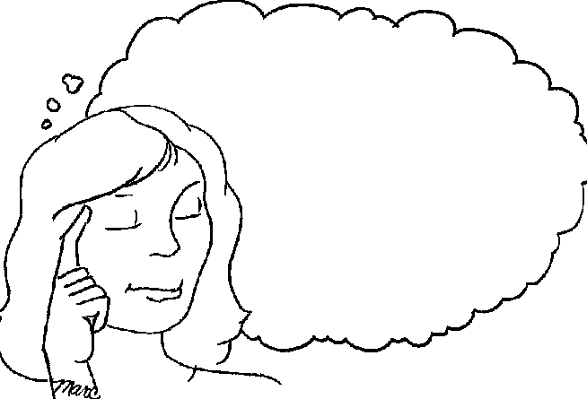
5. Memory moment
What is it: The story pauses to show a flashback to the past
What does it do: Reveals theme, conflict, character development
“Giveaway” signs:
Literal flashback to earlier point in story
Character tells someone about a time in the past
Everything pauses to focus on something before
May overlap with “AHA moment”…

Slide 9
6. Tough questions
What is it: The protagonist wrestles with a difficult and important question.
What does it do: Reveals conflict, theme, possible foreshadowing
“Giveaway” signs:
Usually character asks themselves the question out loud
Character asks themselves question through 1st person narration
Oftentimes the question comes at the end of a chapter
Oftentimes the question comes during an important scene/climax

