Slide 1
A.I. and the “human condition”
Sample presentation by Mr. Schock

Slide 2
Introduction
A.I. is a 2001 science fiction movie directed by Steven Spielberg
A.I. gives a deeply negative portrayal of human life
“The Secret Life of Sea Monsters” is a flash fiction story that is similar
I believe these two stories are too negative in their portrayals of humanity

Slide 3
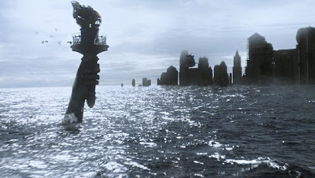
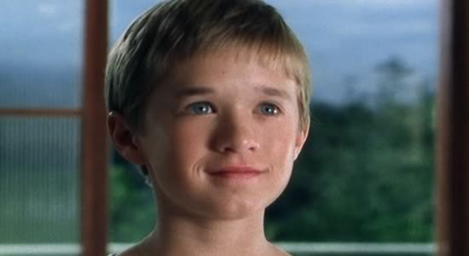
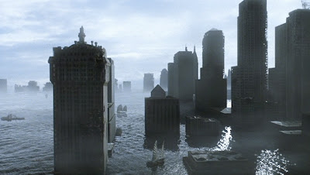
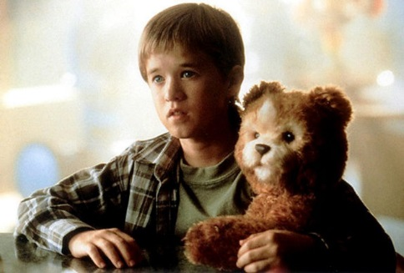
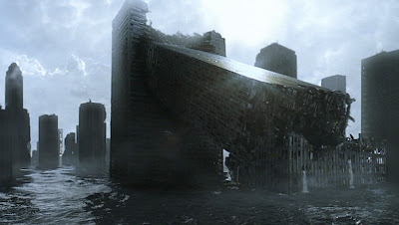
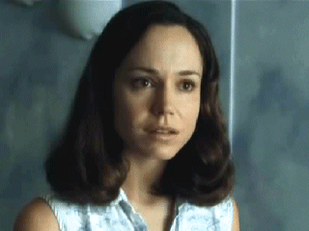
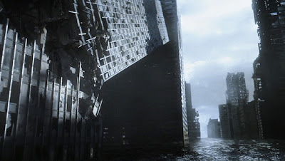
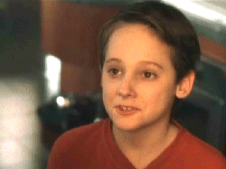
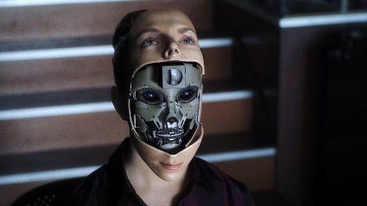
Overview: A.I. (1/3)
Setting: 22nd century, post-global warming
Humans and Mecha
Labor
Love bots
David
David is given trial run by Henry and Monica
Martin’s suspended animation
Family becomes accustomed to David
Monica decides to Imprint

Slide 4
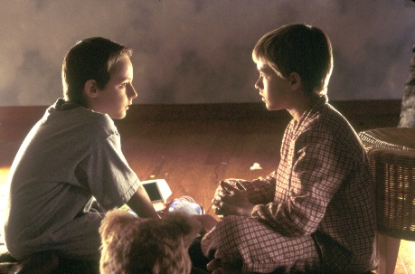
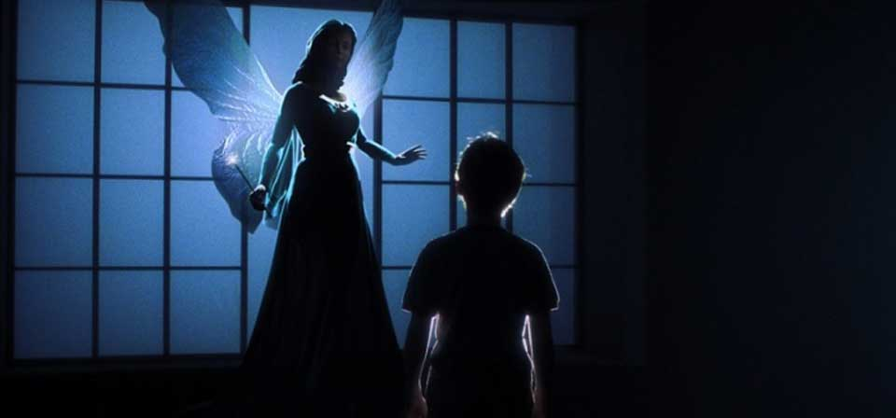
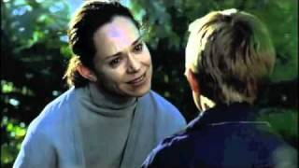
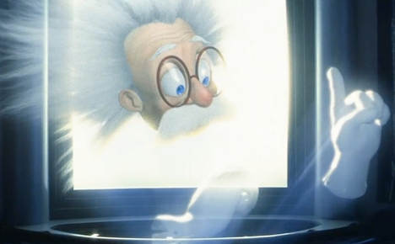
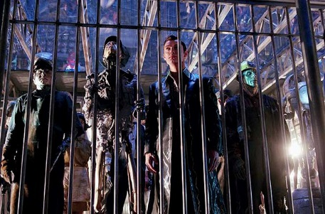
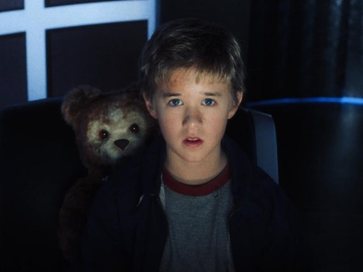
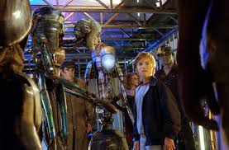
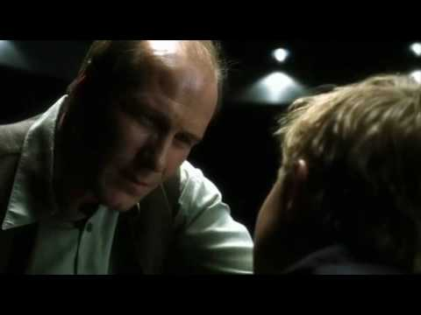
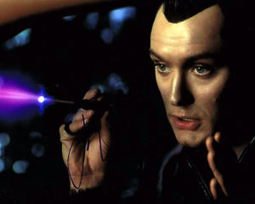
Overview: A.I. (2/3)
Martin’s recovery and revolt against David
Martin: Mommy will love you if you cut off her hair
Monica abandons David rather than return him for destruction
David is captured for “Flesh Fair” (obsolete, unlicensed Mecha)
Gigolo Joe– love bot framed for murder
David chases after the Blue Fairy
David destroys the copies of himself, because he is told he is not special

Slide 5
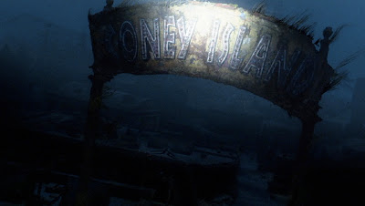
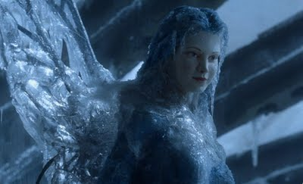
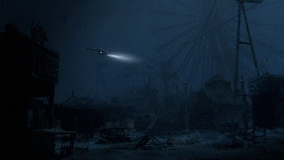
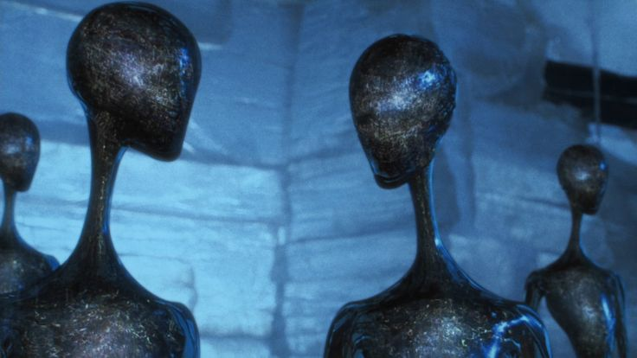
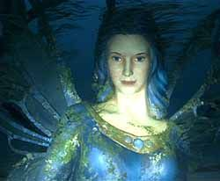
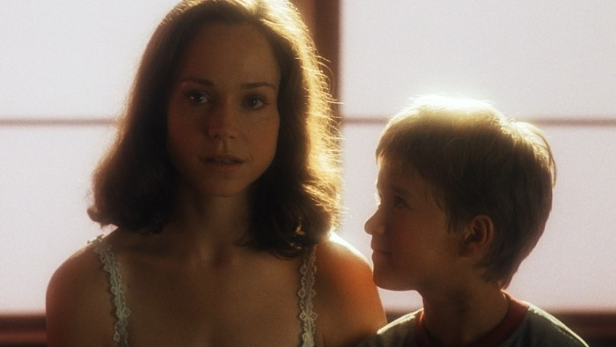
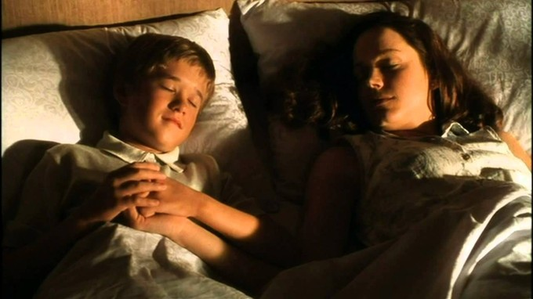
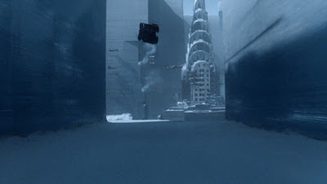
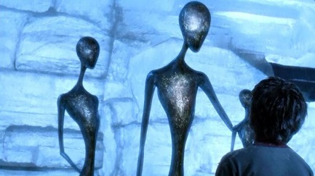
Overview: A.I. (3/3)
David finds Blue Fairy underwater, trapped under Ferris wheel
2,000 years pass and David survives human extinction frozen
Advanced Mecha finds David and Teddy
When David touches the Blue Fairy statue, it shatters
Mother can be cloned for one day
Together they go “to that place where dreams are born”

Slide 6
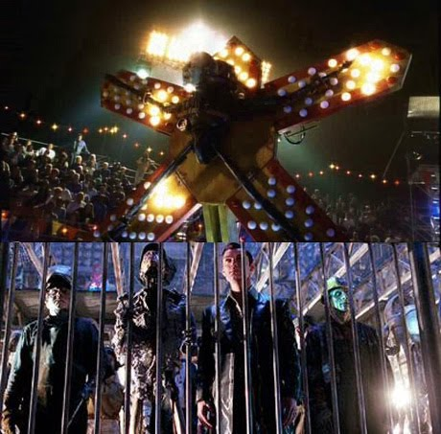
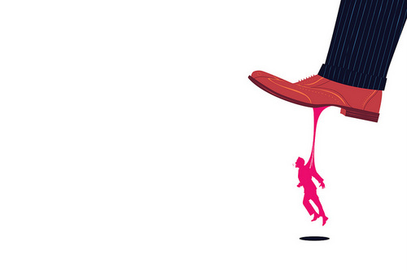
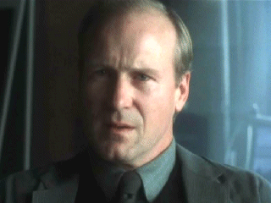
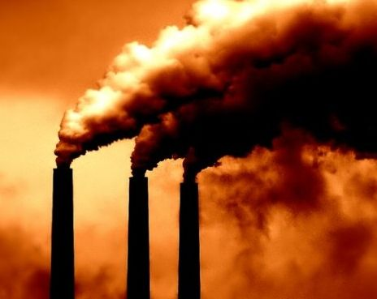
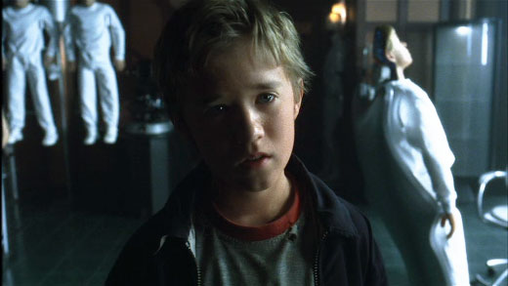
Views on human life: A.I. (1/2)
A.I. has a negative view of humans: They are destructive and jealous, and even when they love others, it can be very painful.
Using others for own benefit: Mecha purposes, replacing children
Discrimination: Humans vs. Mecha
Destruction of natural environment: Global warming
Jealousy: Martin with David, David’s need to be “special”
That ending…

Slide 7
Views on human life: A.I. (2/2)
From Ain’t it Cool blog:
There's two ways to read the ending. The one I think they intended is actually the darker of the two interpretations. You can either say the Future Robots are lying when they tell David they can bring people back from the dead and create an elaborate illusion (ala the Blue Fairy that actually speaks with David) to give him the closure he needs or, even worse, they're telling the truth about the space time continuum storing reflections of every person who has ever existed
For a while I bought into the illusion argument, but these last two viewings convinced me I was wrong and that the Future Robots have no reason to trick David.
I guess you could call the ending bittersweet in that case because then the interaction David has with Monica is real, but it comes with one giant condition. The process of bringing her back is a one-time thing and only lasts for a day and, as they describe it, uses up essentially the last bit of her “soul” that is documented in the fabric of space time.
In short, for David to be with his mother he has to kill her. Not only kill her, but wipe away any trace of her that's left in this universe. Even knowing all that, he doesn't hesitate.
This isn't even taking into account that it's still up for debate whether David dies when he goes “to the place where dreams are born.” I know John Williams has said he scored that moment as if he was scoring David's death, but that's actually the happier of the two endings.
The other option is he doesn't die, but becomes fully human just in time to lose everything and everyone he's ever loved. That possibility depresses me so much that I'm happy to assume he's dead, which is why I'll now start getting upset when people write the ending off as a “tacked on happy ending.” No, sir or madam. Incorrect. The “happy ending” in this instance is that a child dies before the void of eternal loss engulfs him. Yep, real audience pleaser, right?

Slide 8
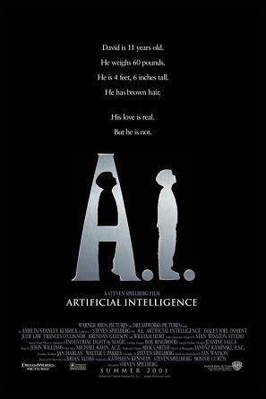
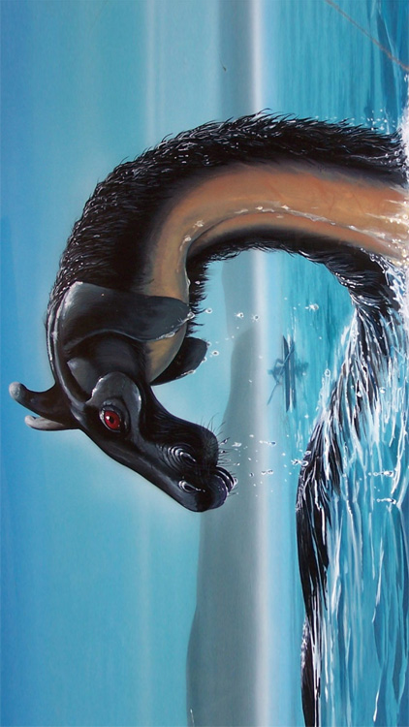
Comparing A.I. and “Sea Monsters” (1)
A.I.’s bleak portrayal of human life is comparable to the view portrayed in the flash fiction story “The Secret Life of Sea Monsters”
“Sea Monsters” describes the daily lives of sea monsters who have disguised themselves as people and secretly live among humans
The sea monsters record what’s happening on earth and draw maps
When they meet together as a family, they share their stories with each other and with their ruler, Leviathan
The sea monsters view humans as “monsters,” but they acknowledge that the rest of the world does have beauty– but the beauty is in nature, not people

Slide 9
Comparing A.I. and “Sea Monsters” (2)
A.I.
“Secret life of sea monsters”
Human pollution led to global warming, destroying the natural environment and reducing human population
Sympathetic characters are Mecha, not human
Humans and Mecha live among each other, but Mecha are discriminated against and used as tools
Ends by showing the beauty of a childlike, humanlike love– but that ending is overshadowed by sadness and bleak reality
Humans destroy the natural environment that the sea monsters love (the sea, the desert, etc.)
Sympathetic characters are sea monsters, not human
Humans and sea monsters live among each other, but humans do not know that the sea monsters are different
Ends by stating that the world above is beautiful, despite the “monsters” there (humans)

Slide 10
Own thoughts
A.I. and “Sea Monsters” depict the “human condition” as living a life of destruction and jealousy, blind to the beauty all around
I generally disagree with the interpretation both stories give
Human nature does involve destruction and jealousy, can be overcome
I think the portrayal of the Mecha and the sea monsters as victims / innocent observers is not necessarily fair
Human nature is not as negative as these stories portray
People can choose destruction and hurt, but they can also choose love and compassion– with learning, empathy, and dedication, people can be good

Slide 11
Works Cited
Quint. “Steven Spielberg's A.I.: Artificial Intelligence - A Revisit.” Ain’t it Cool,
http://www.aintitcool.com/node/72398. Accessed 9 April 2017.
Smith, Cislyn. “The Secret Life of Sea Monsters.” Flash Fiction Online. 2017.
http://flashfictiononline.com/main/article/the-secret-life-of-sea-
monsters/. Accessed 9 April 2017.
Spielberg, Steven. A.I.. Warner Bros., 2001.

