Slide 1
What we’ll be talking about
How an economy works
Economic systems
Capitalism
Socialism
Communism
Fascism
Gov. systems
Democracy
Dictatorship

Slide 2
How does an economy work?
Nations must answer 3 basic Economic questions:
What goods and services should be produced?
How should the goods and services be produced?
For who should the goods and services be produced?
The way a nation answers these questions defines their economy.

Slide 3
Supply and Demand
If there is too much of something or it is easy to get, the price will probably _____________.
If there is not enough of something or it is hard to get, the price will probably _____________.

Slide 4
Capitalism
Private ownership
Free-market economy
Prices dictated by supply and demand
Aided the Industrial Revolution
Often exploited the working class

Slide 5
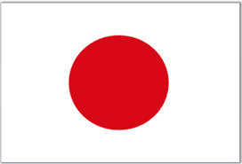
Capitalism
The United States and Japan are examples of a Capitalist Economy

Slide 6
Socialism
Means of production are owned by the state, for the benefit of all
Rejection of free-market capitalism
Government-planned “command economy”
Concern for social justice

Slide 7
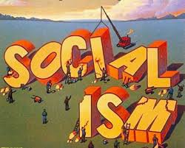
Socialism
Increased government involvement in people’s lives and the economy

Slide 8
Socialism
The main goal is to keep prices low for all people and to provide employment for many

Slide 9
Socialism
The government runs key industries and makes economic decisions

Slide 10
Socialism
More social services for all and free or low cost medical care

Slide 11
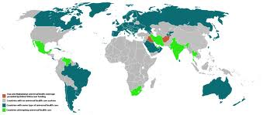
Socialism
Canada, Germany, Sweden, Australia and Great Britain are all examples of socialist economies

Slide 12
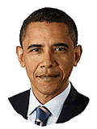
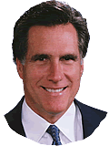
Left vs. Right on Economics
“Left” / Liberal (More Socialist) | “Right” / Conservative (More Capitalist)

Slide 13
Karl Marx and Friedrich Engels
Communist Manifesto
Bourgeoisie (haves) vs. proletariat (have-nots)
Made worse by Industrial Revolution
Working class should overthrow oppressors
“…they have nothing to lose but their chains.”

Slide 14
Communism
Community shares in production and goods
Complete form of socialism
Shared ownership
Equal distribution
“From each according to his ability; to each according to his need.”

Slide 15
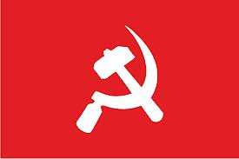
Communism
Only one political party, the Communist party, runs the government

Slide 16
Communism
All people able to work are assigned jobs – there is virtually no unemployment

Slide 17
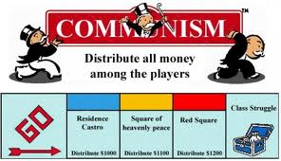
Communism
The government assigns housing, schools, and occupations

Slide 18
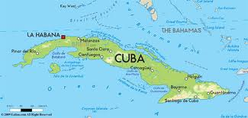
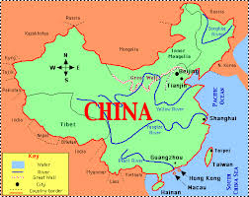
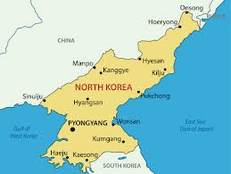
Communism
Cuba, North Korea, and China are examples

Slide 19
You have two cows…

Slide 20
You have two cows…
Socialism: The government takes them and puts them in a barn with everyone else's cows, then gives you as much milk as it thinks you need.
Communism: Your neighbors help you take care of them and everyone shares the milk.
Capitalism: You sell one and buy a bull.
Communism

Slide 21
The Failure of Communism
Said economic factors alone drove social change
But religion, ethnicity, and nationalism do too
Said Industrial Revolution would bring extreme inequality
But that was limited by government reforms

Slide 22
Fascism
Fascism is a fourth economic system. If Communism is the “extreme” version of Socialism, Fascism can be somewhat accurately called the “extreme” version of Capitalism.
Fascist nations put priority on funding military and rely on strong nationalism (patriotism).

Slide 23
Economic systems and Gov. organization
Economic systems (Capitalism, Socialism, and Communism) are related to gov. types (Democracy, dictatorship) but are not the exact same thing.
Capitalism and Socialism are linked to democracy, where people vote politicians into office to make laws that benefit the people.
Fascism and Communism have both turned to dictators.
Communism in theory actually leads to anarchy– no government. However, Communist nations have had powerful dictators with single parties instead. The theory has been to concentrate power in one party and then eventually eliminate the need for that party.

